Slide 1


9ᵗʰ International Conference for Convergence in Technology
(9ᵗʰ I2CT 2024)
Cognitive Algorithms: Machine Learning's Role in Alzheimer's Early Detection
Paper ID: 1735 .
PRESENTER NAME :Srujitha Devineni .
SRM UNIVERSITY - AP .

Slide 2

Contents
01
Introduction
02
Alzheimer's Disease Overview
03
Data Set Statistics
04
Methodology
05
Research findings
06
Model evaluation
07
Performance metrics
08
Conclusion
09
References

Slide 3
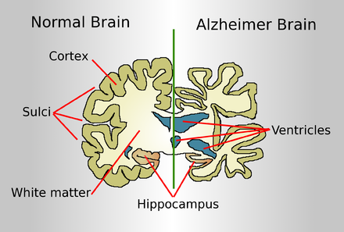
Introduction
Our research explores machine learning and deep learning techniques for predicting Alzheimer’s disease using numerical data and MRI scans.
It demonstrates the potential of machine learning in aiding early Alzheimer’s diagnosis, crucial for personalized treatment.

Slide 4
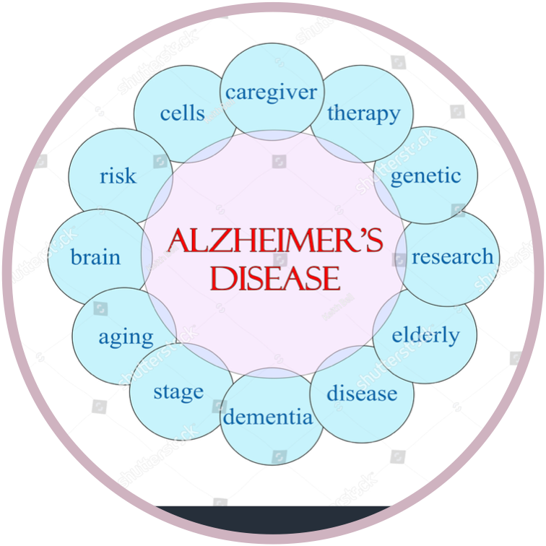
Alzheimer's Disease Overview
Alzheimer's disease is a devastating condition that progressively impairs cognitive function, including memory, language, and decision-making abilities.
The disease not only affects the individual diagnosed but also has far-reaching implications for their families, caregivers, and society as a whole.
As Alzheimer's progresses, individuals may experience difficulties with daily tasks, changes in personality and behavior, and challenges in communication.
Early detection of Alzheimer's is vital for accessing appropriate care and support services, as well as for potentially slowing down the progression of the disease.
Alzheimer's places a significant economic burden on healthcare systems, with costs associated with medical care, long-term care, and lost productivity.
Research into Alzheimer's disease is ongoing, aiming to develop better diagnostic tools, treatments to slow or halt the disease progression, and ultimately find a cure.

Slide 5

Data Set
Statistics
- Numerical Dataset:
Source: Kaggle
File: "oasis_longitudinal.csv"
Missing Values: "SES" and "MMSE"
Handling: Replaced with medians for model robustness
- MRI Image Dataset:
Source: Kaggle
Categories: "Moderate_Demented," "Mild_Demented," "Very_Mild_Demented," "Non_Demented"
Image Counts:
Moderate_Demented: 64
Mild_Demented: 896
Very_Mild_Demented: 2240
Non_Demented: 3200

Slide 6
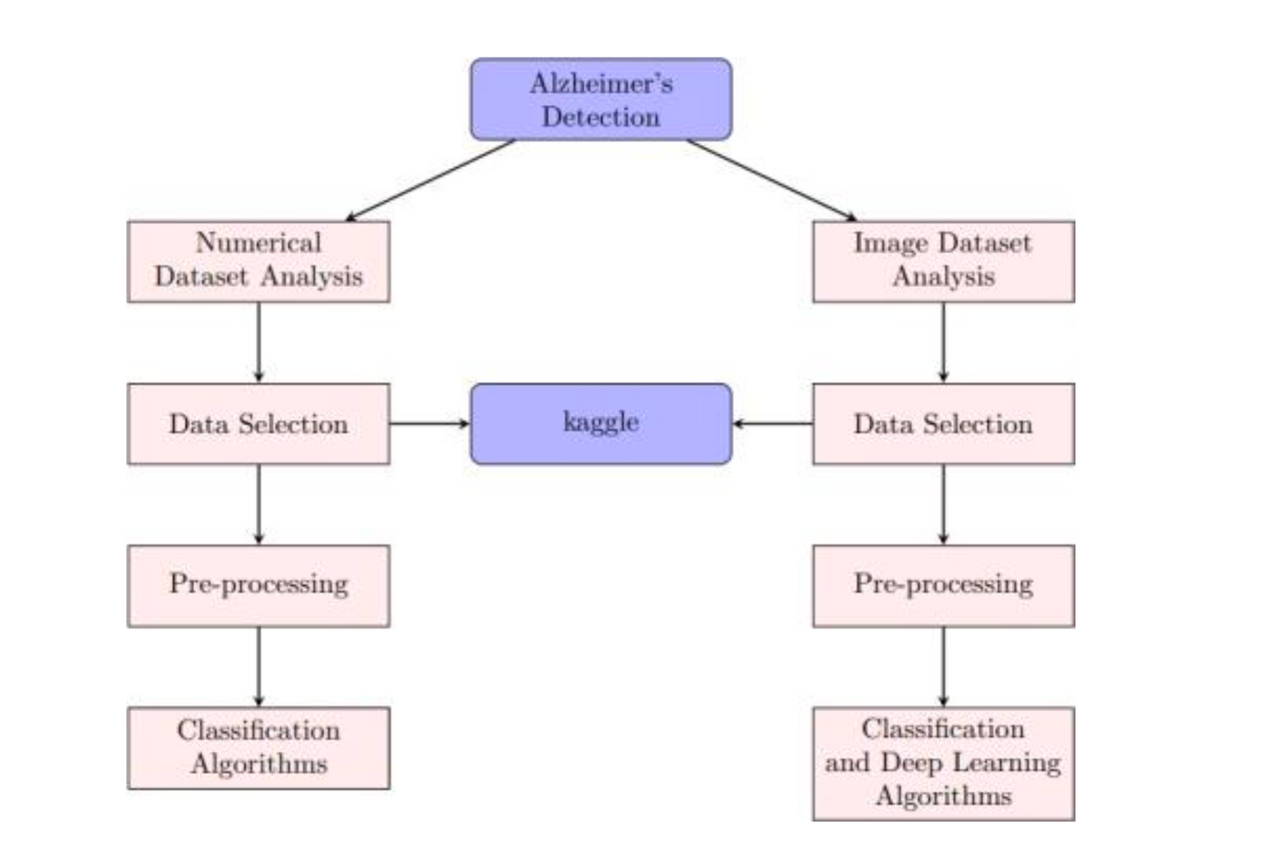
Methodology
For detecting Alzheimer's we followed a dual approach by Utilizing numerical and MRI image dataset
Numerical Analysis
Image Analysis

Slide 7
Methodology
01
01
Data Selection:
-Obtained from Kaggle: "oasis longitudinal.csv".
-Includes demographic info, cognitive scores, and brain properties.
02
02
Data Preprocessing:
-Handling missing values with median imputation.
-Standardization of groups for uniform classification.
03
03
Exploratory Data Analysis (EDA):
-Gender analysis and education correlation.
-Correlation matrix to understand feature relationships.
04
04
Implementation of Algorithms:
-Logistic regression, Gaussian Naive Bayes, Bernoulli Naive Bayes, KNN.
Decision Tree Classifier, Random Forest Classifier, SVM.
AdaBoost Classifier, XGBoost Classifier.
05
05
Algorithm Performance:
-Accuracies ranged from 56% to 84%.
-Key predictors: Age, MMSE, eTIV.

Slide 8
Methodology
01
Data Selection:
-Obtained from Kaggle: Alzheimer's MRI images.
-The data was Categorized into stages of Alzheimer's disease.
01
02
Data Preprocessing:
-Sizing, loading, and normalization.
-Data augmentation for diversity.
-Feature extraction with VGG16.
02
03
Implementation of Algorithms:
03
-SVM, Logistic Regression, Multinomial Naive Bayes, KNN,Decision Tree, CNN, ANN.
04
04
Algorithm Performance:
-Accuracies ranged from 66.56% to 98.91%.
-CNN accuracy: 87.5%, ANN accuracy: 80.86%

Slide 9
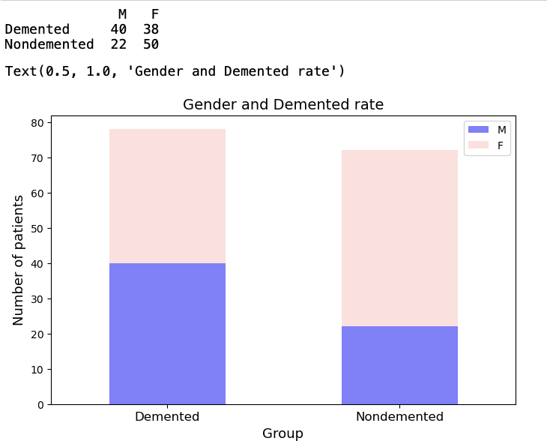
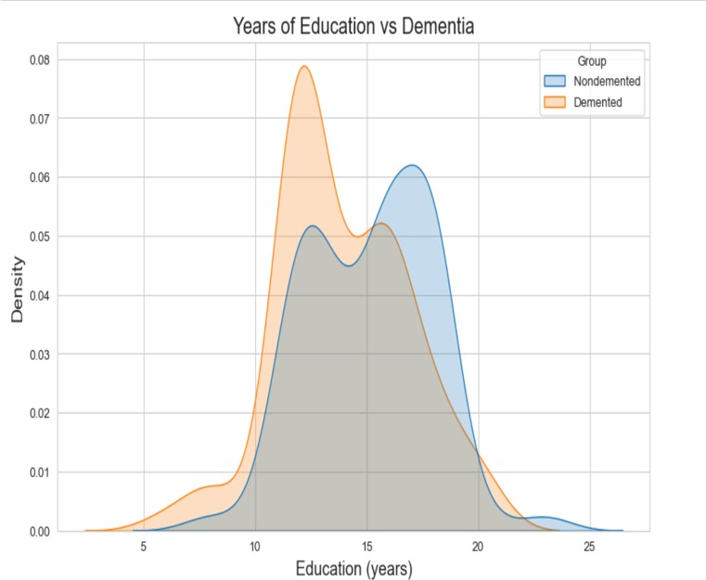
RESEARCH FINDINGS
GENDER ANALYSIS REVEALED A HIGHER PREVALENCE OF DEMENTIA AMONG MEN (40 INSTANCES) COMPARED TO WOMEN (38 INSTANCES), WITH NON-DEMENTED CASES SHOWING A SIMILAR TREND. THIS SUGGESTS A GENDER-SPECIFIC PATTERN IN ALZHEIMER'S DISEASE, INDICATING A POTENTIAL NEED FOR TAILORED APPROACHES IN DIAGNOSIS AND TREATMENT.
THE ANALYSIS SHOWED A CLEAR RELATIONSHIP BETWEEN EDUCATION LEVELS AND DEMENTIA STATUS: DEMENTIA PATIENTS GENERALLY HAD LOWER EDUCATION, WHILE NON-DEMENTED INDIVIDUALS TENDED TO HAVE HIGHER EDUCATIONAL ATTAINMENT.

Slide 10
Model evaluation
Accuracy: It represents the overall correctness of the model's predictions,In Alzheimer's disease detection, accuracy measures how well the model correctly identifies both positive and negative instances among all instances.
Accuracy = Number of Correct Predictions/Total Number of Predictions
Precision: Precision quantifies the accuracy of positive predictions,In Alzheimer's detection, It measures how many of the predicted positive cases are actually true positive cases .High precision suggests that when the model predicts Alzheimer's, it is often correct, minimizing false positives.
Precision=(True Positives)/(True Positives + False Positives​)
Recall (Sensitivity): Recall measures the model's ability to capture all positive instances,In Alzheimer's detection, recall assesses how well the model identifies true positive cases among all actual positive cases. High recall indicates that the model effectively identifies individuals with Alzheimer's disease, minimizing false negatives.
Recall= (True Positives) / (False Negatives + True Positives)
F1 Score: It is the harmonic mean of precision and recall , In Alzheimer's disease detection, F1 score provides a balanced measure of the model's accuracy, considering both false positives and false negatives.A high F1 score indicates a model that performs well in terms of both precision and recall, striking a balance between avoiding false positives and false negatives.
F1-Score=2×( Precision * Recall)/(Precision+Recall)

Slide 11
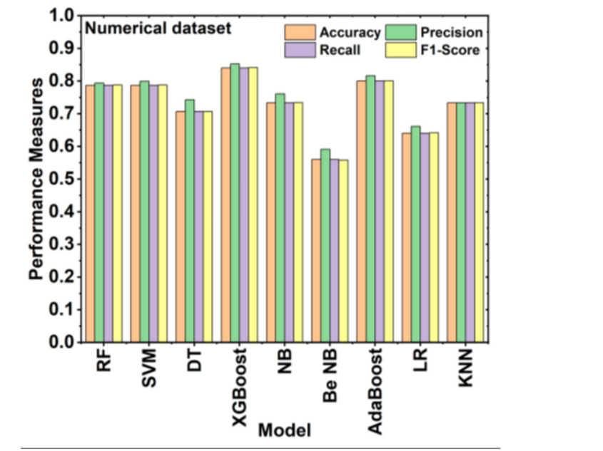
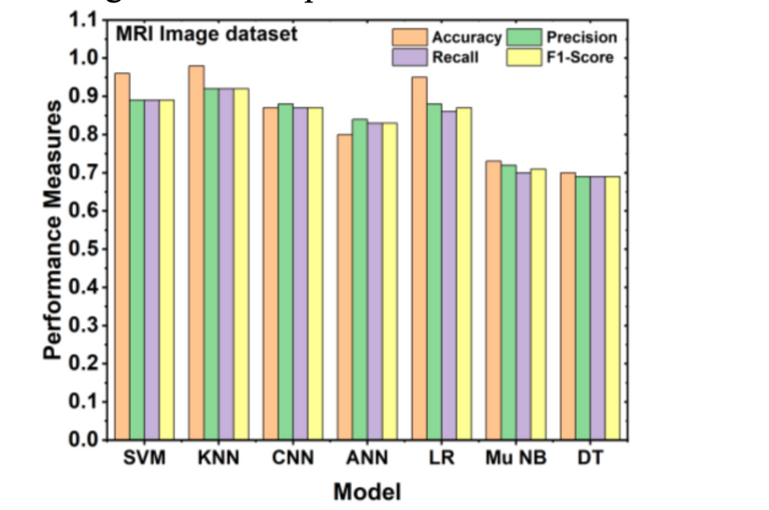
performance metrics
Performance measures of different models performed on the numerical dataset.
Best Performer: XGBoost model consistently outperforms other models across all performance measures (accuracy, precision, recall, F1-Score).
Worst Performer: Bernoulli Naive Bayes model consistently shows the lowest performance across all performance measures.
XGBoost model demonstrates consistent high performance across all measures, while Bernoulli Naive Bayes consistently shows lower performance.
Performance measures of different models performed on the MRI image dataset.
Best Performer: KNN model consistently outperforms other models across all performance measures (accuracy, precision, recall, F1-Score).
Worst Performer: Decision Tree model consistently shows the lowest performance across all performance measures.
KNN model demonstrates consistent high performance across all measures, while Decision Tree consistently shows lower performance.

Slide 12
Conclusion
In concluding our study on Alzheimer's disease identification, our innovative approach merges MRI and numerical datasets with diverse machine learning and deep learning algorithms.
Our in-depth analysis of the numerical dataset highlighted the effectiveness of XG Boost, achieving an outstanding 84% accuracy, particularly notable when incorporating cross-validation.
The MRI image dataset exhibited remarkable accuracies, notably with KNN (98%), CNN (87%) and SVM (96.25%), showcasing the capability to accurately diagnose Alzheimer's using MRI images.
The meticulous application of cross-validation ensures the reliability and consistency of our findings.
Future research could focus on:
-Investigating sophisticated feature engineering methods unique to Alzheimer’s symptoms.
-Research effects of unbalanced datasets on model performance for focused enhancements.
-Enhancing numerical dataset pre-processing procedures.
-Collaborating with healthcare organizations to integrate real-world patient data, . addressing issues with data quality and demographics.

Slide 13




REFERENCES
Kapasi, A., & Schneider, J. A. (2016). Vascularcontributions to cognitive impairment, clinical Alzheimer's disease, and dementia in older persons.
Blennow, K., de Leon, M. J., & Zetterberg, H. (2006).Alzheimer's disease. The Lancet, 368(9533), 387-403.
Porsteinsson, A. P., Isaacson, R. S., Knox, S., Sabbagh,M. N., & Rubino, I. (2021). Diagnosis of early Alzheimer’s disease: clinical practice in 2021
Bari Antor, M., Jamil, A. H. M., Mamtaz, M., MonirujjamanKhan, M., Aljahdali, S., Kaur, M., ... & Masud, M. (2021). A comparative analysis of machine learning algorithms to predict alzheimer’s disease. Journal of Healthcare
Masters, C. L., Bateman, R., Blennow, K., Rowe, C. C.,Sperling, R. A., & Cummings, J. L. (2015). Alzheimer's isease. Nature reviews disease primers, 1(1), 1-18.
Scheltens, P., De Strooper, B., Kivipelto, M., Holstege,H., Chételat, G., Teunissen, C. E., ... & van der Flier, W.M. (2021). Alzheimer's disease. The Lancet, 397(10284), 1577-1590.
Wang, J., Huang, S., Wang, Z., Huang, D., Qin, J., Wang,H., ... & Liang, Y. (2023). A calibrated SVM based on weighted smoothGL1/2 for Alzheimer's disease prediction. Computers in Biology and Medicine, 158, 106752.
Mueller, S. G., Weiner, M. W., Thal, L. J., Petersen, R. C.,Jack, C. R., Jagust, W., ... & Beckett, L. (2005). Ways toward an early diagnosis in Alzheimer's disease:

Slide 14
Thank
you!

